Slide 1
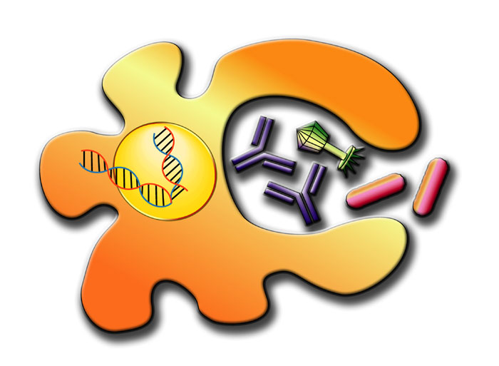
The Immune System: The players and how they protect

Slide 2

We are covered in and CONSTANTLY interact with microbes.

Slide 3
Pathogenic microbe
We are covered in and CONSTANTLY interact with microbes.
The Immunity Dance:
Immune System

Slide 4
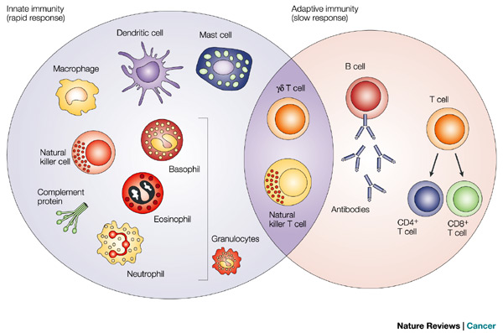
We are covered in and CONSTANTLY interact with microbes.
INNATE IMMUNE CELLS
ADAPTIVE IMMUNE CELLS
ADAPTIVE IMMUNE CELLS
Notes:
Activated b cells can then create antibodies, which can all for a memory response.
T cells- develop into CD4 and CD8 cells. In truth they divide into a lot more shades of t-cells. CD8 t cell is called the killer t cell- when it sees a cell infected with a microbe it will kill that cell because it has been programmed to do so.
The CD4 cell is the helper cell, it helps b cells, macrophages, and CD8 cells.

Slide 5
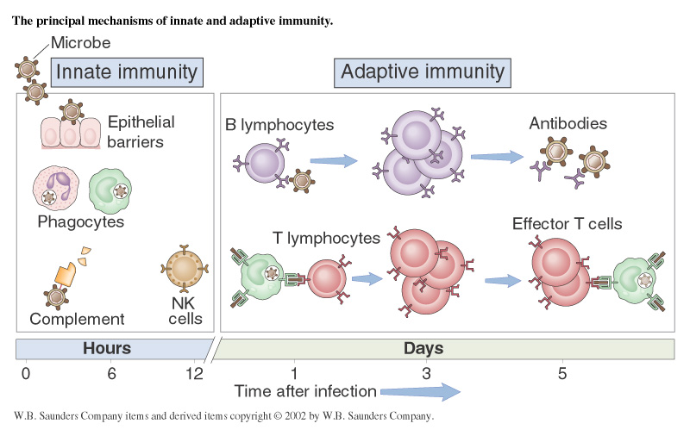
The Immune System: 2 Waves
Notes:
B cells and T cells are heavy artillary

Slide 6
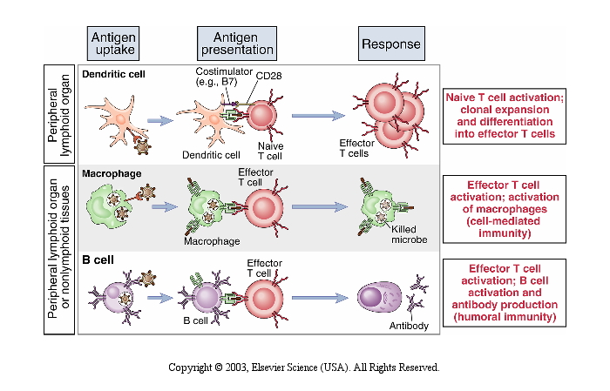
It just takes good communication:
Notes:
Communication is key… our immune system relies on cells communicating with each other through protein protein interactions

Slide 7
Characteristics:
Inducibility- must be activated to respond.
B. Specificity- only the pathogen/antigen
that activates it will be recognized.
C. Memory- Once that pathogen has
been “seen” and responded to, the
immune system will “remember” it.
Notes:
There are only a few number of cells hanging out in the lymphatic system, but once they are induced they activate the other cels to response and ramp up the others.
These cells also have to be very specific in what they respond to, which has to do with what and how they are trained.
T-cells: thymus
B-cells: bone marrow
B cells and T cells die off after fighting off the infection. A small number are retained in lymphatic system so they can respond the next time they see the same infection.

Slide 8
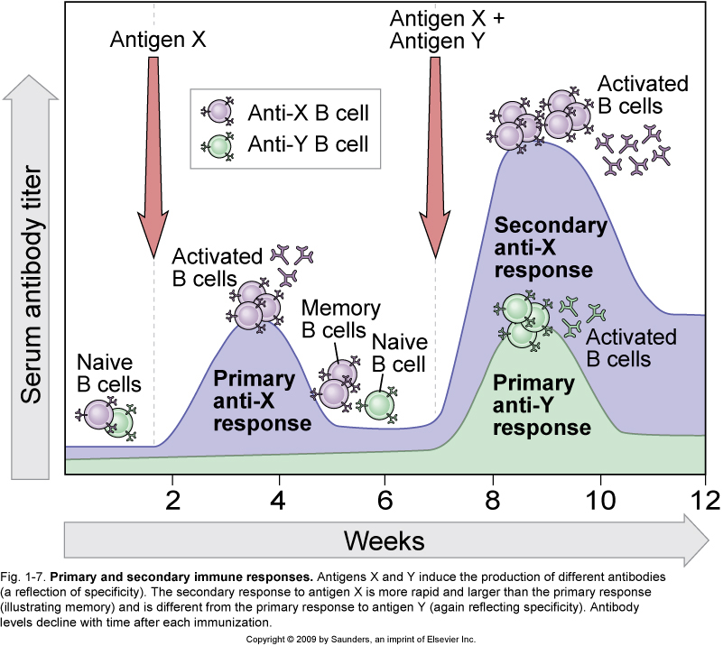

Slide 9
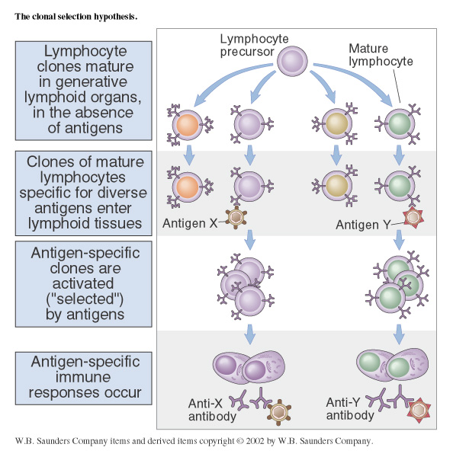
Only a subset of cells will respond to each infection
It takes time to activate and gather the specific cells that will eliminate a specific pathogen.
Notes:
In the case of acute respiratory illnesses and death, it is possible that folks are dying because the immune response was too pronounced.
Not every b-cell and t-cell graduates from their school house, they get killed off because they respond too strongly or not strongly enough.

Slide 10
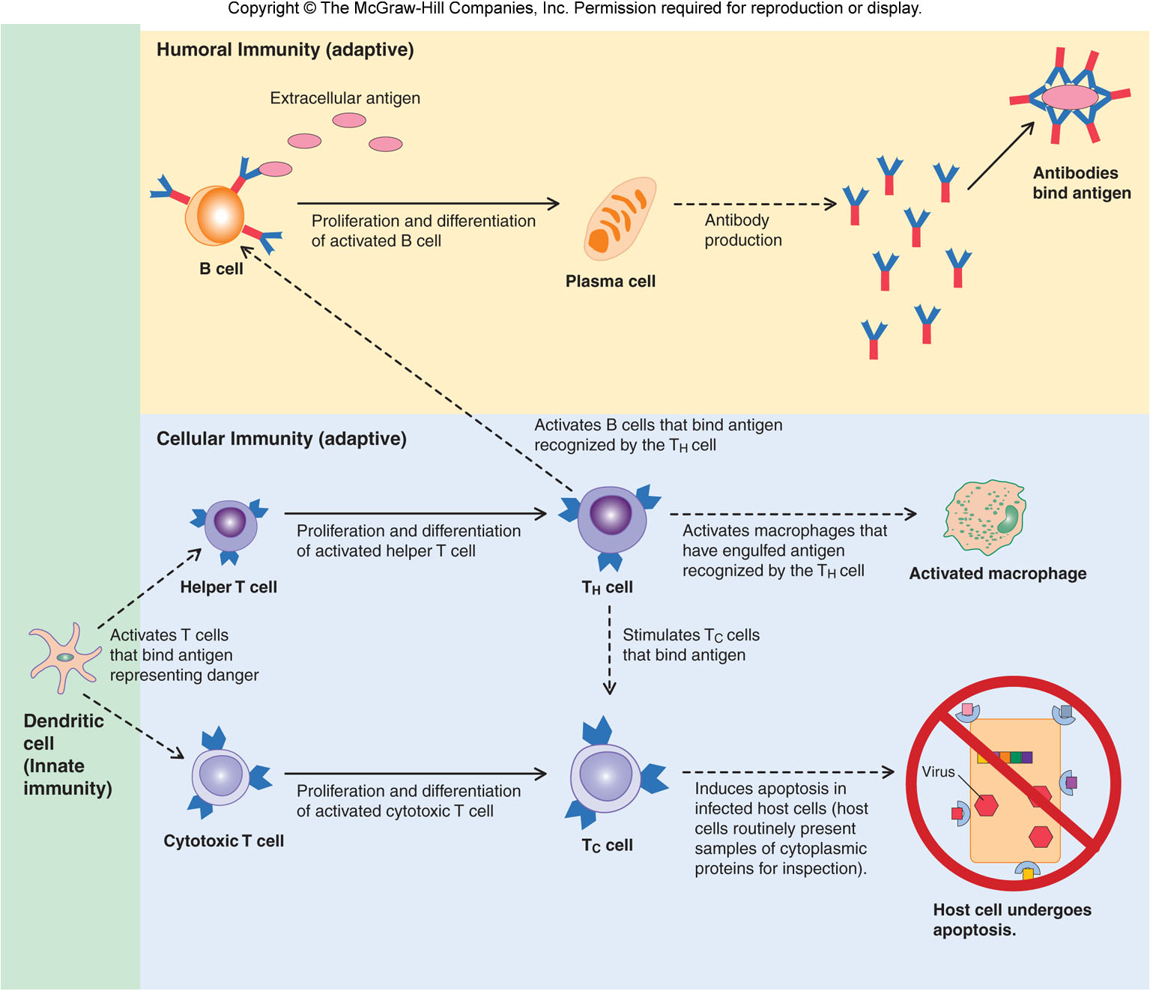

Slide 11
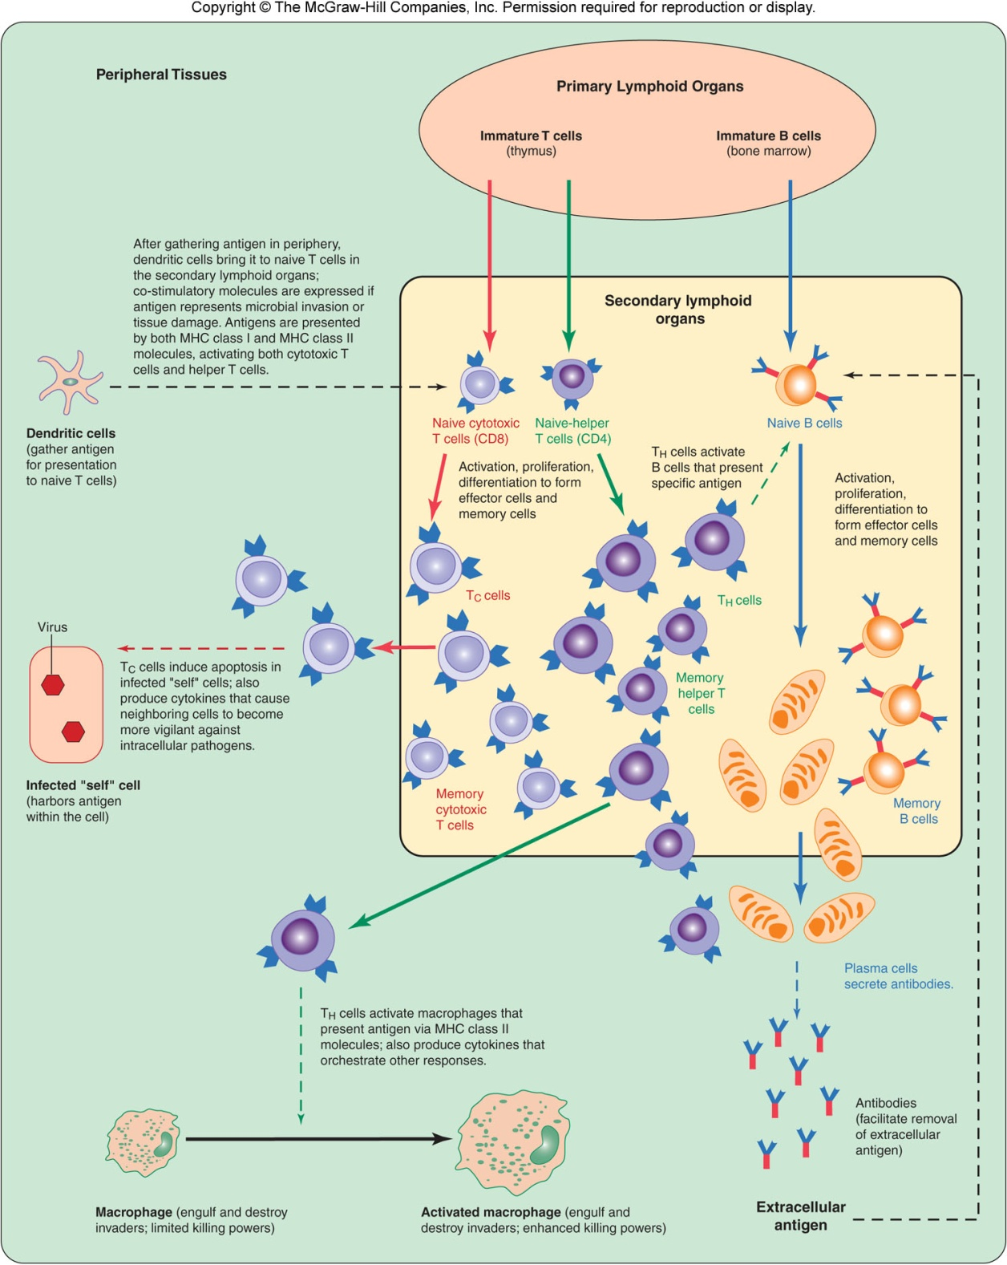
Both B lymphocytes and T lymphocytes mature from a primary to secondary lymphoid organs.
Notes:
Secondary lymphoid organs carry very organized t cell and b cell to induce a localized, quick response.

Slide 12
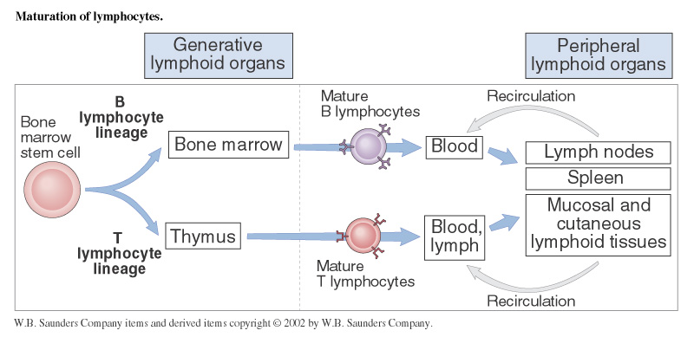
Primary
Secondary

Slide 13
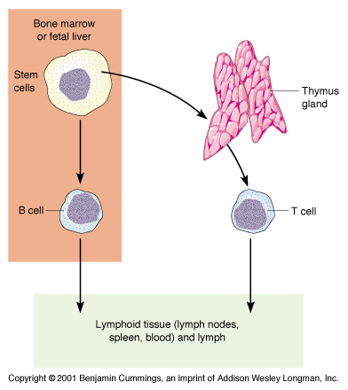
B cell
T cell

Slide 14
Positive selection
If a T or B cell receptor must learn what it is supposed to bind to.
If it can bind and function, it is POSITIVELY selected to leave the thymus and become a mature, naïve cell.
If it cannot bind to the antigen then it is deleted (killed off) in positive selection
Negative selection
If a lymphocyte binds TOO strongly to its receptor, it will be deleted.
Notes:
When the
If the signaling responses are “too strong”
Our cells respond to a certain way to self proteins versus non-self proteins and during both the positive and negative selection process, t and b cells are exposed to self and non self proteins. At that time they are “tested” on whether or not the respond appropriately to both self and non self proteins.

Slide 15
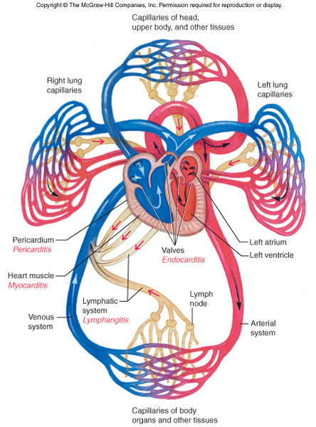
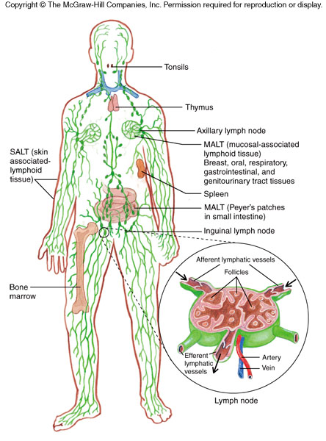

Slide 16
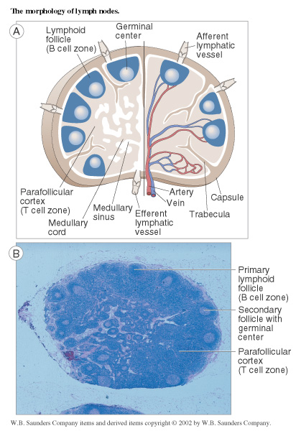
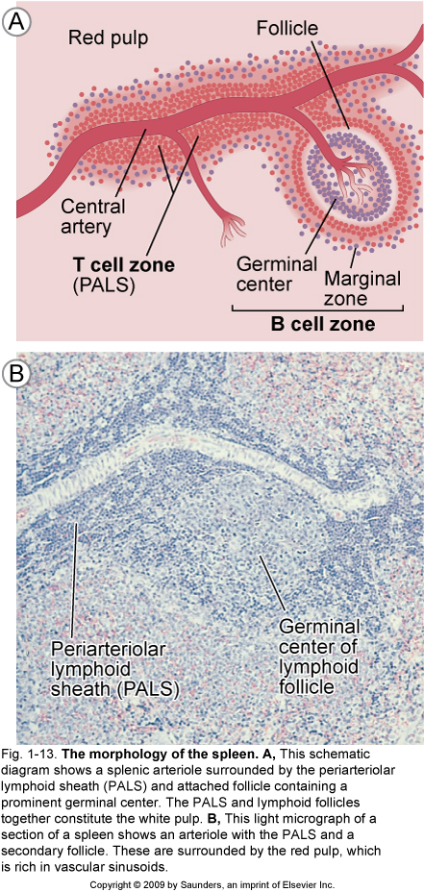
Notes:
B cell zone is lymphoid follicle and parafolliculral cortex is the t cell zone and they don’t really hang out until an antigen shows up

Slide 17
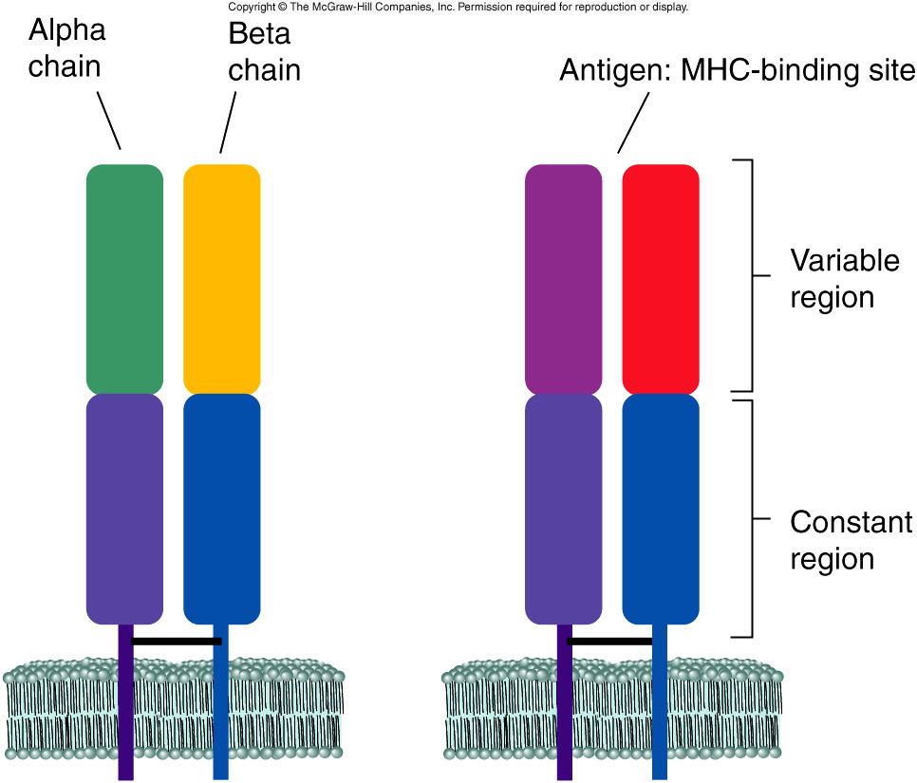
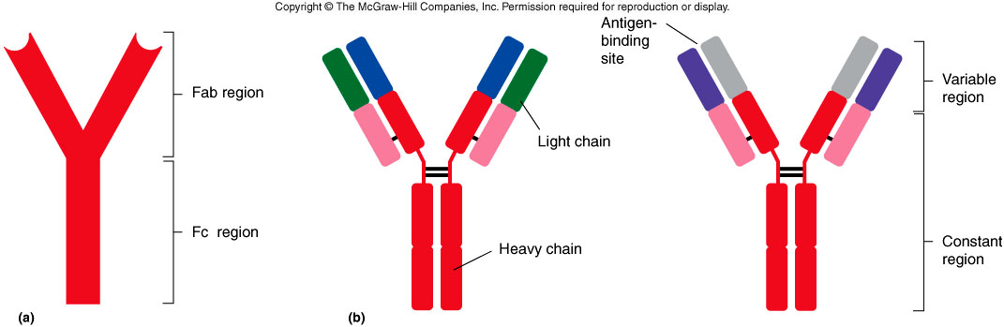
RECEPTORS:
T cell
B cell
Notes:
Antibodies are very robust at clearing infection

Slide 18
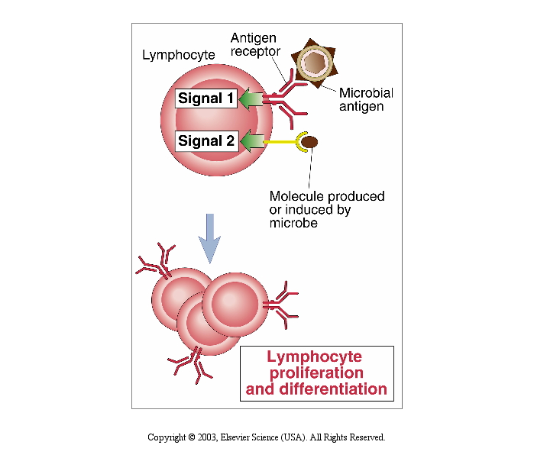

Slide 19
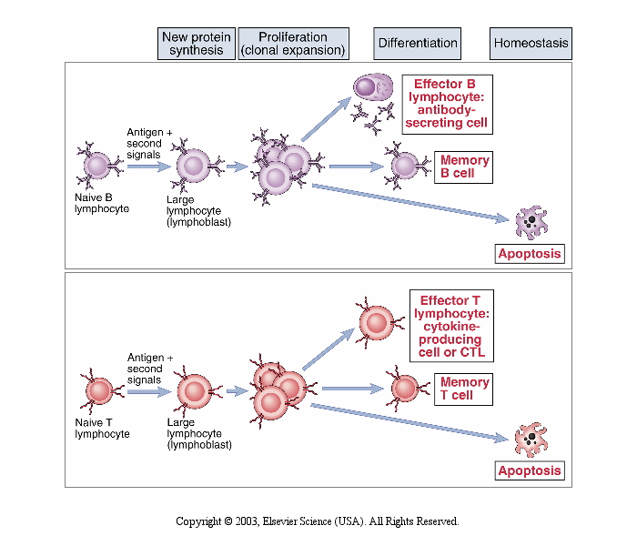
Notes:
Cells have been trained to get both signals and are necessary for lymphocyte proliferation and differentiation.

Slide 20
All naïve lymphocytes will undergo clonal expansion as well as production of a memory response as long they have been activated with two signals.

Slide 21
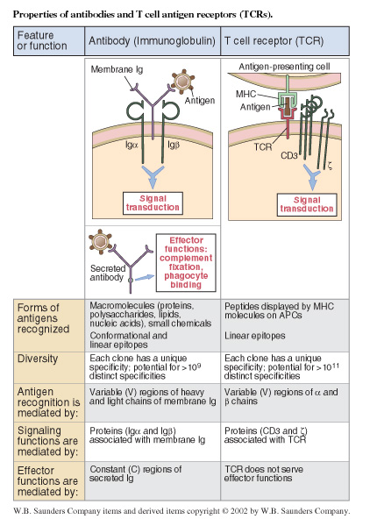
Signaling-

Slide 22
Wrap Up: Adaptive Immune System

Slide 23
Wrap Up: Adaptive Immune System
1) Cell Types: T and B - Communication!

Slide 24
Wrap Up: Adaptive Immune System
Cell Types: T and B - Communication!
Functions: T- Cell Mediated, B- Antibody production.

Slide 25
Wrap Up: Adaptive Immune System
Cell Types: T and B - Communication!
Functions: T- Cell Mediated, B- Antibody production.
Location

Slide 26
Wrap Up: Adaptive Immune System
Cell Types: T and B - Communication!
Functions: T- Cell Mediated, B- Antibody production.
Location
Education

Slide 27
Wrap Up: Adaptive Immune System
Cell Types: T and B - Communication!
Functions: T- Cell Mediated, B- Antibody production.
Location
Education
Activation/Expansion/Retraction/Memory!

Slide 28
Wrap Up: Adaptive Immune System
Cell Types: T and B - Communication!
Functions: T- Cell Mediated, B- Antibody production.
Location
Education
Activation/Expansion/Retraction/Memory!
Signaling!

